Slide 1
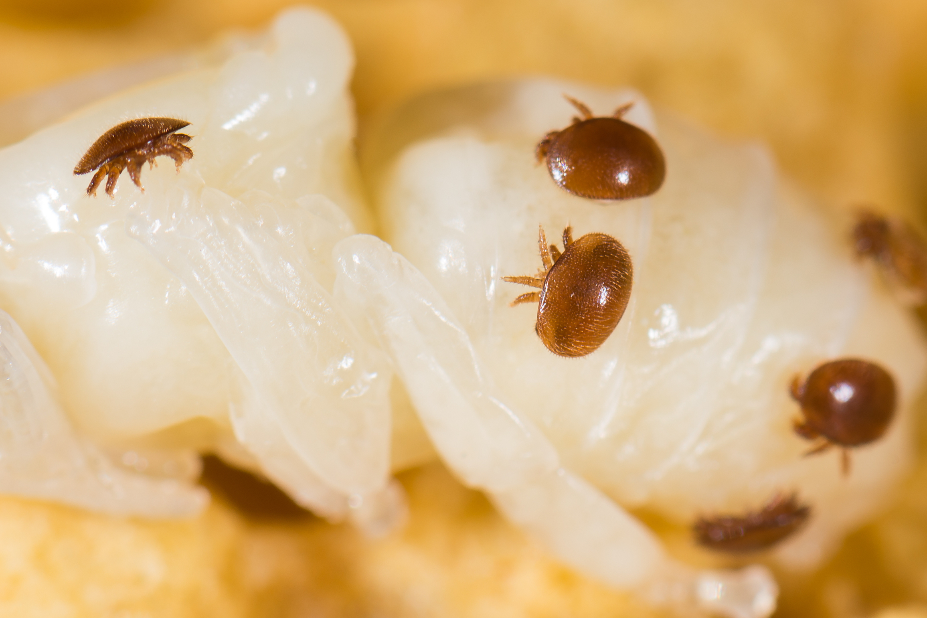
Bee Sustainability Challenges
Varroa – is one of our biggest challenges in overwintering bees.

Slide 2
Bee Starvation
Unfortunately this is more common than we think.
During the dearth (late July – August) the hive is strong and if the beekeeper didn’t leave enough honey in the hive this can be a problem.
After the frost, the nectar flow stops until Spring. The bees must have enough honey stored to make it through the winter. Monitor and feed if necessary.
When inspecting your hives, “Show me the Honey”

Slide 3
Bees Robbing
Again during the dearth, strong hives will often rob weaker hives, causing the weak hives to lack food and die of starvation or diseases.
Bees either make honey or Take honey.
The strong hive will go in the weaker hive, kill the queen and take the all the honey within days.
Protect your hives by reducing the entrance so they can be more protective. You can also purchase anti-robbing screens.,

Slide 4
Diseases and Pest of the hive.
American Foulbrood – Infectious brood disease caused by Spore-forming bacterium
European Foulbrood – is a bacterial brood disease
Chalkbrood- a fungal brood disease
Sacbrood – a disease caused by a virus and usually does not result n severe loss
Parasitic Mite Syndrome – complex symptoms of viruses & mites
Nosema- are microsporidian parasite that cause infections.
Deformed Wing Virus

Slide 5
Register your bees with the Ohio Department of Agriculture. It is a $5 dollar registration fees for your entire Apiary
You will receive an experience inspector that will check your hives for diseases and other issues of sustainability. Well worth the $5.00.

